Slide 1
Pulseq
the eternal loop of everything
inspired by Qu-Bit Electronix Eurorack module Bloom

Slide 2

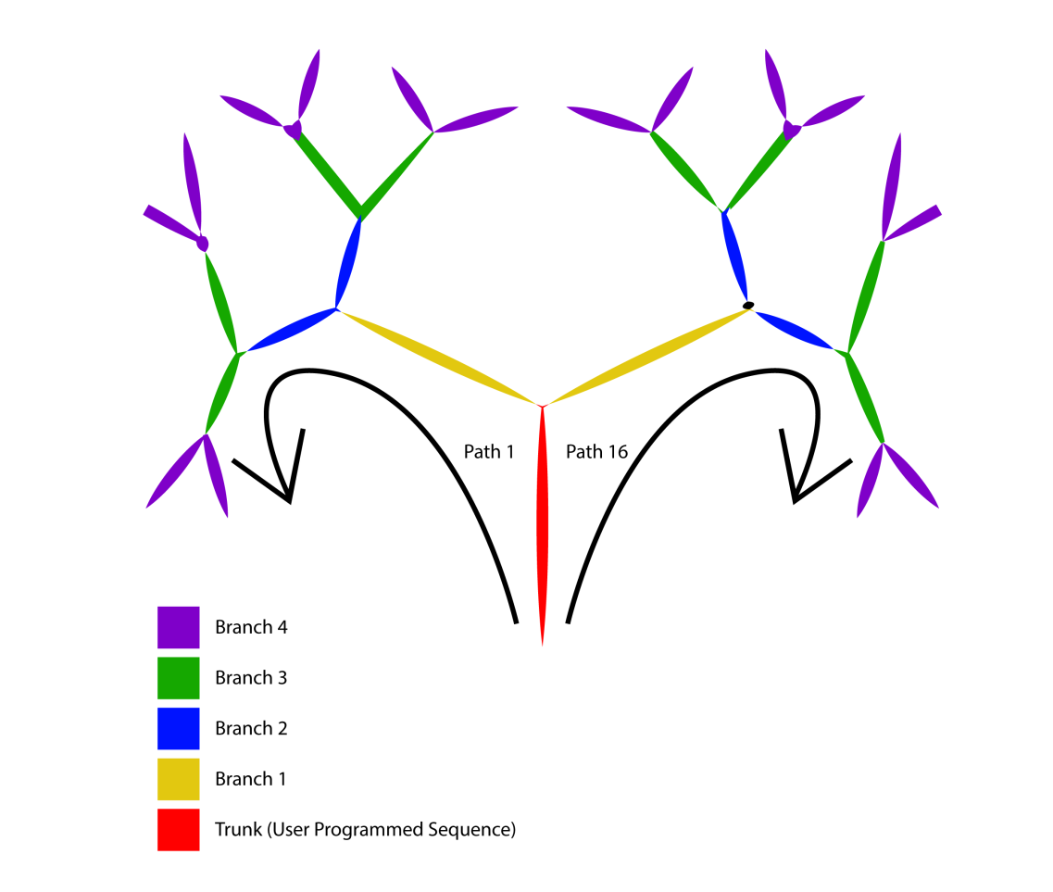
Concept
Fractal Sequencer:
User Programmed Sequence (Trunk)
Recursive Tree Generation
branches: number of related subsequences that will extend the trunk sequence (tree levels)
path: sets the direction followed by the fractal sequence
After the Trunk sequence has been played, the sequence will continue on the next tree's branch following the selected path.

Slide 3
Notes
The subsequence for the next branch will be related to the subsequence of the previous branch, not to the Trunk sequence (except the first branch obviously). This allows the musical evolution of a simple melody.
Everytime the Trunk is adjusted or the number of branches is changed, the entire tree is regenerated.

Slide 4
Generative Transformations
Transposition
The previous sequence is transposed up or down by as much as one octave (twelve semitones).
Inversion
The previous sequence is inverted so that the highest note in the sequence is now the lowest, and vice versa.
Reversal
The previous sequence is reversed so that the first note in the sequence is now the last, and vice versa.
Mutation
The previous sequence is mutated so that some notes are adjusted up or down as much as an octave.

Slide 5
Programming the Trunk sequence
Notes Mode
Default mode
Knobs can be used to tune the note for each step of the sequence
possible notes for each step are set according to the selected scale starting from note A3
Controls Mode
Activated by holding down the ctrl key
Global sequence controls:
Length
Tempo
Scale
Order
Transpose
Div/Mult
Repeat
Slew

Slide 6
Sounds and Effects
Eight different sounds can be used to play the sequences.
The sound can be enhanced by controlling the dry/wet mix of three pre-set effects:
Distortion
Reverb
Ping-Pong Delay
Knobs that control the effects are available in control mode

Slide 7
Shortcuts
ctrl+M: mute/unmute the sequence playback
… more to be added

Slide 8
Implementation
Single-Page Application (SPA) implemented using Svelte component framework
Why Svelte? It differs from frameworks like Vue and React for:
No Virtual DOM diffing
More compact syntax = less code to write
True reactivity: Svelte runs at build time, converting your components into highly efficient imperative code that surgically updates the DOM
Coding Principles
UI Atomic Design
Configurability (configuration are provided through the config.js file)
Encapsulation
External dependencies
Tone.js - Sound and Effects
Tonal - Music Theory
ThreeJS - GLSL shaders

Slide 9
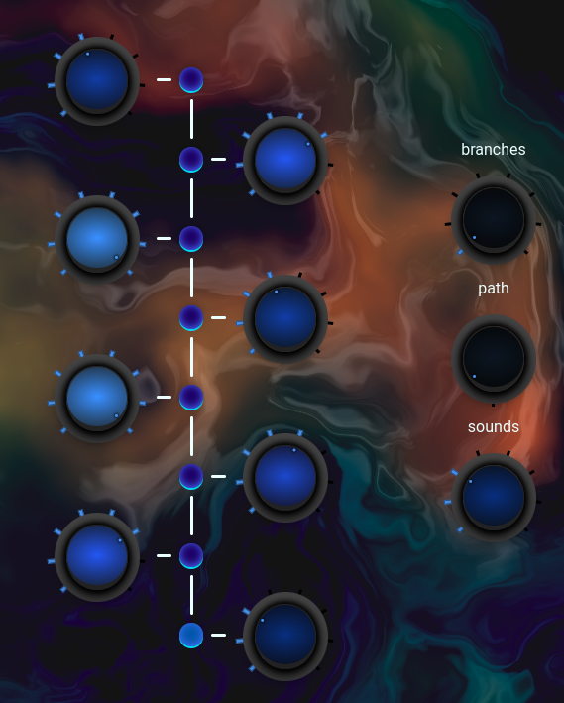
Components
Atoms
Knob
LED
Background
Molecules
Sequencer
Splash Screen
Other components
Effects
Synths
Main application

Slide 10
Hosting and CI/CD
Project hosted on GitHub public repository
Development:
Set up: npm install
Run local instance: npm dev
Run production preview instance: npm preview
Release:
Automatic deploy to GitHub Page
Workflow triggered on commit push or merged pull request for the main branch
Steps:
Install - npm ci
Build - npm run build
Upload artifact (dist folder)
Deploy

Slide 11
Next steps
Work on the available sounds
Improve background shader performance (high GPU usage)
UI/UX implementation for mobile devices
In-app walkthrough
Features implementation:
Automatic counterpoints generator
Multi-page trunk sequence (to extend the 8 steps length limit)
Sequences save and recall

Slide 12
demo

